Slide 1
Differentially Private Analysis of U.S. Household Income Statistics
using Laplace and Gaussian Mechanisms
Muttaki I Bismoy
Shomitro K Ghosh
Farhan Tanvir &
Ahmad Jadallah
CIS 545
Data Security and Privacy
Team CyberSentinels
Notes:
Bismoy

Slide 2

01
Motivation & Problem
Why this project?
Public socioeconomic datasets risk privacy leakage
Household income is highly sensitive
Need for privacy-preserving statistical releases
Differential Privacy (DP) solves reconstruction & inference attacks
CIS 455
Data Security and Privacy
Team CyberSentinels
Notes:
Bismoy

Slide 3
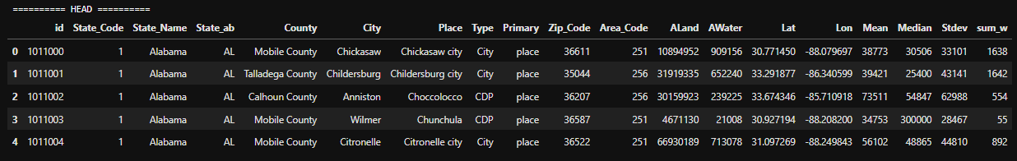
02
Dataset Overview
Includes:
Dataset: U.S. Household Income Database
(70,000+ geographic regions)
Mean, median, stdev income, population, geolocation, land/water area.
From dataset documentation:
hi_mean = mean household income
hi_median
hi_stdev
pop, ALand, AWater, lat, lng, state, city
325,260 records across U.S.
CIS 455
Data Security and Privacy
Team CyberSentinels
Notes:
Bismoy

Slide 4
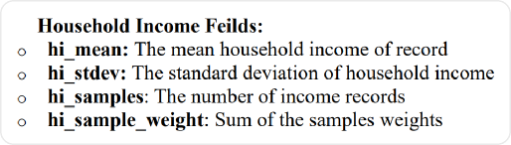
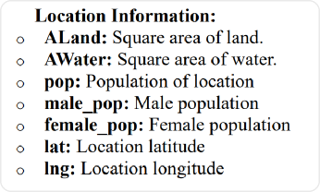
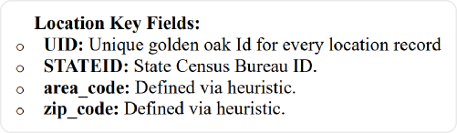
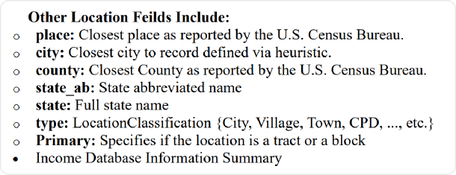
03
Key Data Fields
Main Fields Used
hi_mean, hi_median, hi_stdev – Income statistics used for DP analysis
pop (sum_w) – Population / sampling weight for regional scaling
lat, lng – Spatial coordinates for geographic income mapping
ALand, AWater – Land and water area for regional characteristics
State, County, City identifiers – Administrative grouping for EDA
Zip_Code, id – Unique geographic identifiers
CIS 455
Data Security and Privacy
Team CyberSentinels
Notes:
Bismoy

Slide 5
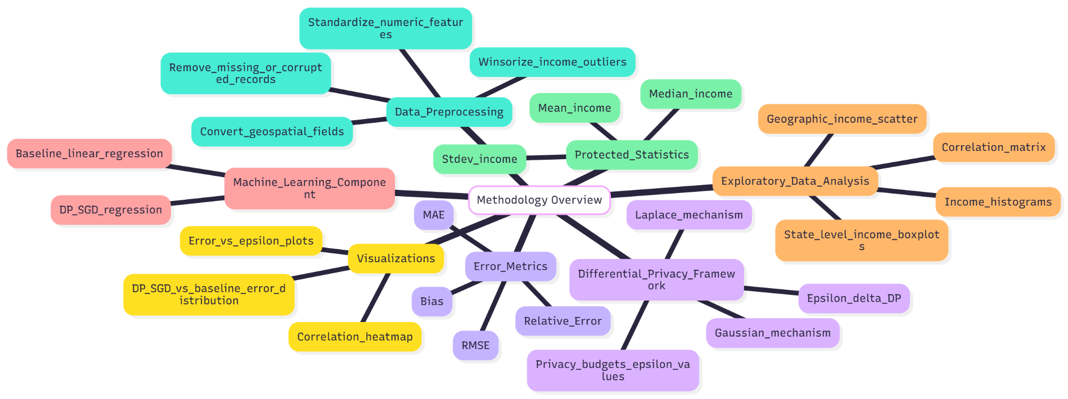
04
Methodology Overview
Fig 2. Methodology Overview
Data cleaning & preprocessing
Exploratory Data Analysis
Apply Laplace & Gaussian mechanisms
Compute errors: Bias, MAE, RMSE, Relative Error
Train Baseline Regression vs DP-SGD
Evaluate privacy–utility trade-off
CIS 455
Data Security and Privacy
Team CyberSentinels
Notes:
Bismoy

Slide 6
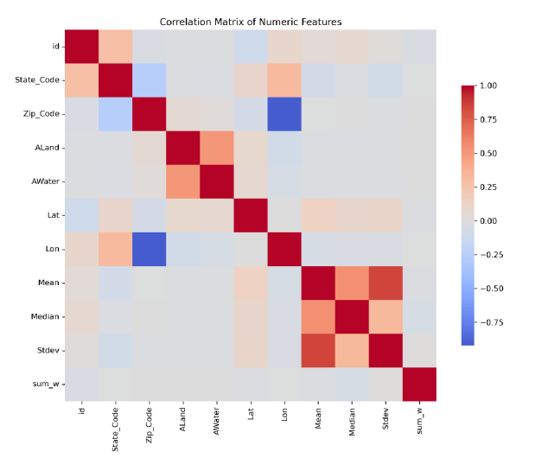
05
Exploratory Data Analysis
Highlight findings:
Income is right-skewed
Strong correlation between mean, median & stdev
Income is right-skewed
Fig 2. Correlation Matrix of Numeric Features
CIS 455
Data Security and Privacy
Team CyberSentinels
Notes:
Bismoy

Slide 7
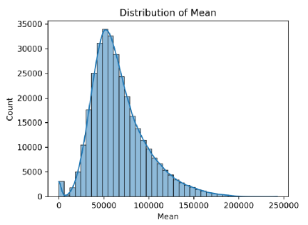
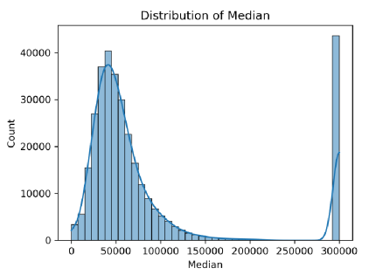
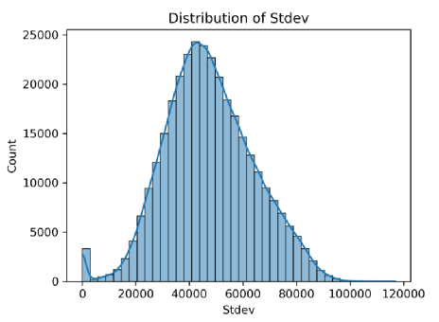
06
Income Distributions
Income Distributions histograms
All income distributions are heavy-tailed
High skew → DP noise impact increases
Fig 3: Histograms for Mean, Median and Standard Deviation of household income. All three exhibit right-skewed heavy-tail
distributions typical in socioeconomic variables
CIS 455
Data Security and Privacy
Team CyberSentinels
Notes:
Bismoy

Slide 8
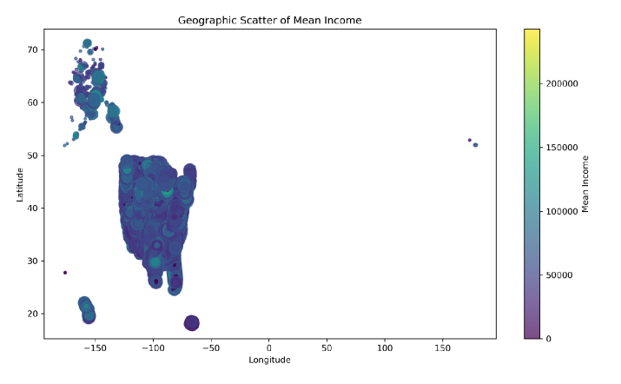
07
Geographic Distribution
Visual showing strong clustering
Key insights:
Coastal states show higher income
Rural areas show lower spread
Fig 4. Geographic scatter plot of mean household income across U.S. regions. Color intensity corresponds to income,
revealing strong spatial socioeconomic clustering
CIS 455
Data Security and Privacy
Team CyberSentinels
Notes:
Bismoy

Slide 9
08
Differential Privacy Framework
(ε, δ)-Differential Privacy
Laplace Mechanism for pure DP
Gaussian Mechanism for approximate DP
Laplace noise: Laplace(0, Δf / ε)
We apply DP to:
Gaussian noise: σ = sqrt(2 ln(1.25/δ)) * Δf / ε
ε values tested: {0.05, 0.1, 0.5, 1, 2, 5}
Mean household income
Median household income
Standard deviation
CIS 455
Data Security and Privacy
Team CyberSentinels
Notes:
Shomitro

Slide 10
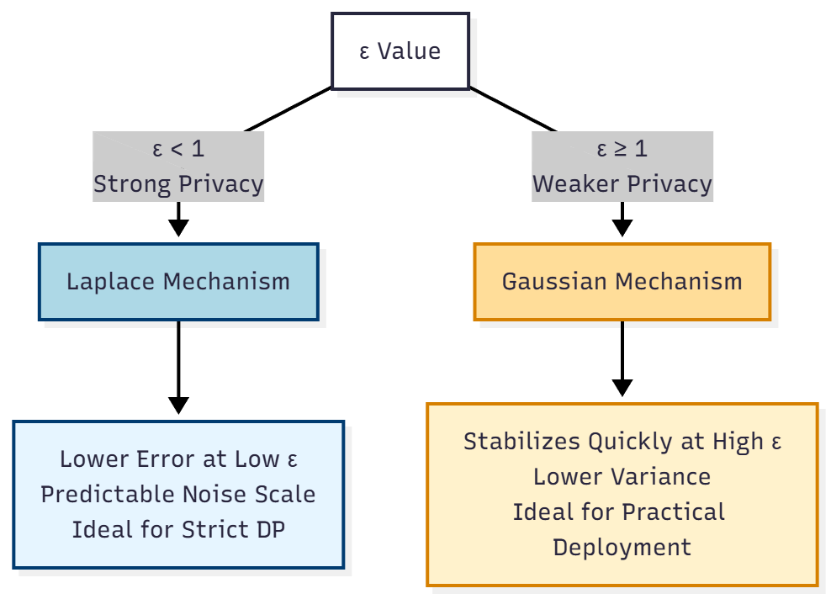
09
Interpreting Laplace vs Gaussian Mechanisms
Why Laplace Performs Better at Low ε (Strong Privacy):
Laplace noise is scaled by Δf / ε, producing a tighter noise distribution.
Works well when ε is tiny because the added noise grows linearly and remains predictable.
This method yields fewer extreme values, which in turn leads to lower MAE, RMSE, and Relative Error at low values.
This method is more appropriate for pure DP scenarios that demand strict guarantees.
Why Gaussian Stabilizes Faster at High ε (Weaker Privacy):
Gaussian noise adds variance proportional to σ = √(2 ln(1.25/δ)) · (Δf / ε).
At small ε, the variance is large → more outliers → higher errors.
At moderate and high ε, variance rapidly shrinks, causing the Gaussian mechanism to stabilize and outperform Laplace.
Gaussian handles high-dimensional or aggregated statistics more smoothly, improving performance at ε ≥ 1.
CIS 455
Data Security and Privacy
Team CyberSentinels
Notes:
Shomitro

Slide 11
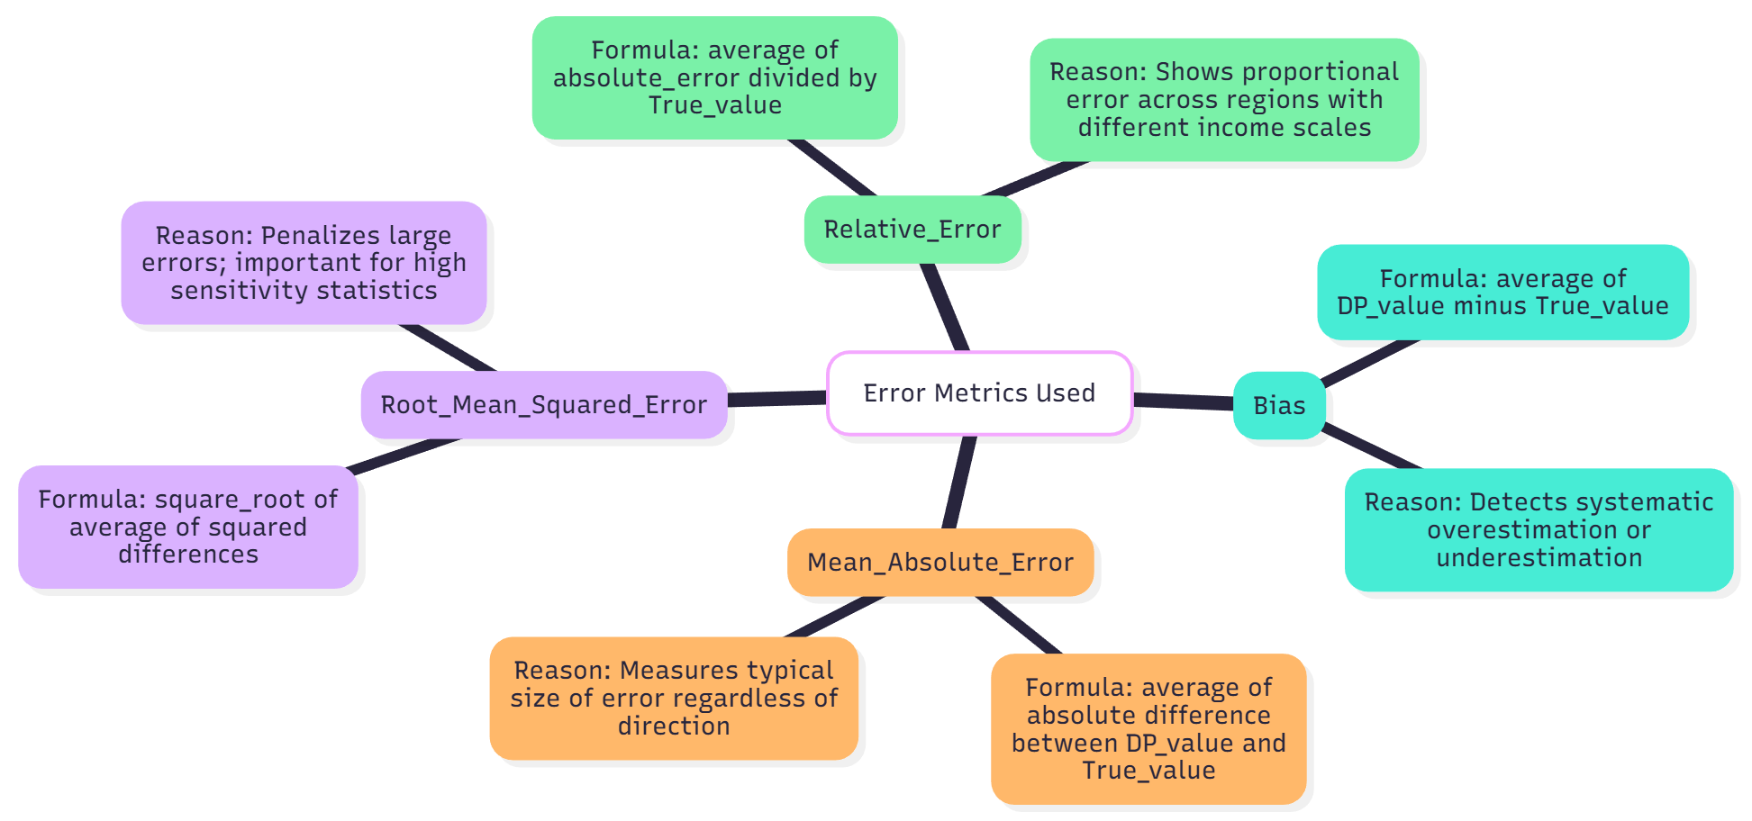
10
Error Metrics Used
Define:
Bias
Mean Absolute Error (MAE)
Root Mean Squared Error (RMSE)
Relative Error
Fig 5. Bias, MAE, RMSE and RE are the error matrices used for this project. Their formula and reason behind using them are stated in this figure.
CIS 455
Data Security and Privacy
Team CyberSentinels
Notes:
Shomitro

Slide 12
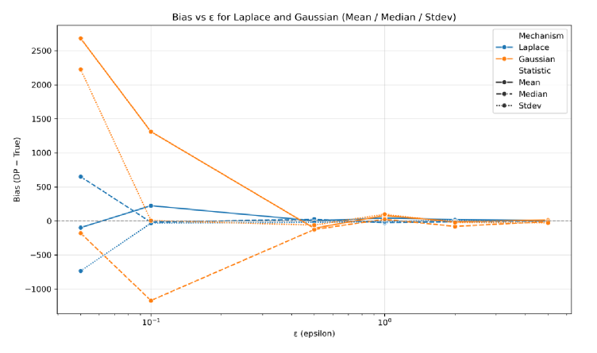
11
Results: Bias vs ε
Key points:
Laplace bias high at low ε
Gaussian stabilizes faster
Median most sensitive
Fig 6. Bias vs ε for Laplace and Gaussian
CIS 455
Data Security and Privacy
Team CyberSentinels
Notes:
Shomitro

Slide 13
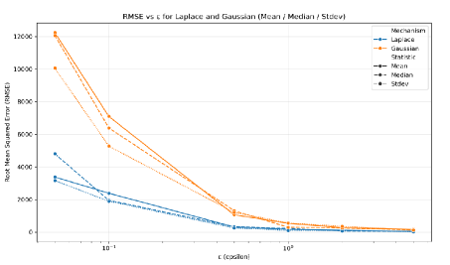
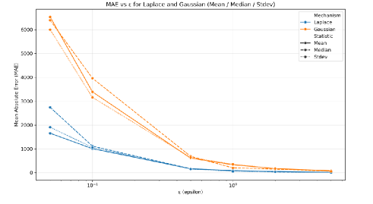
12
Results: MAE & RMSE Trends
Insights:
Error decreases exponentially as ε increases
Gaussian performs better at mid-high ε
Laplace competitive at ε < 1
Fig 7. MAE and RMSE for Laplace and Gaussian mechanisms across varying privacy budgets (𝜖). Each
panel compares mean, median and standard deviation perturbations
CIS 455
Data Security and Privacy
Team CyberSentinels
Notes:
Farhan

Slide 14
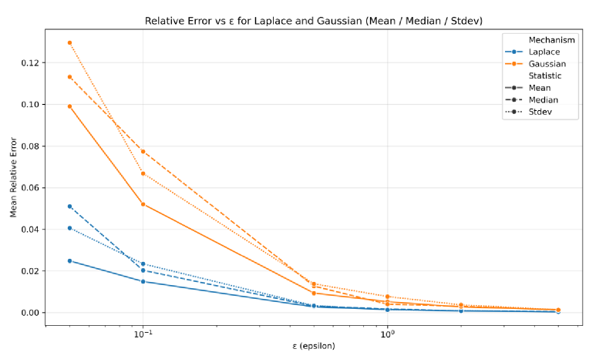
13
Relative Error Comparison
Observations:
Relative error extremely high at ε=0.1
Drops near zero at ε≥10
Mean least sensitive to noise
Fig 8. Relative Error for Laplace and Gaussian mechanisms across varying privacy budgets (𝜖)
CIS 455
Data Security and Privacy
Team CyberSentinels
Notes:
Farhan

Slide 15
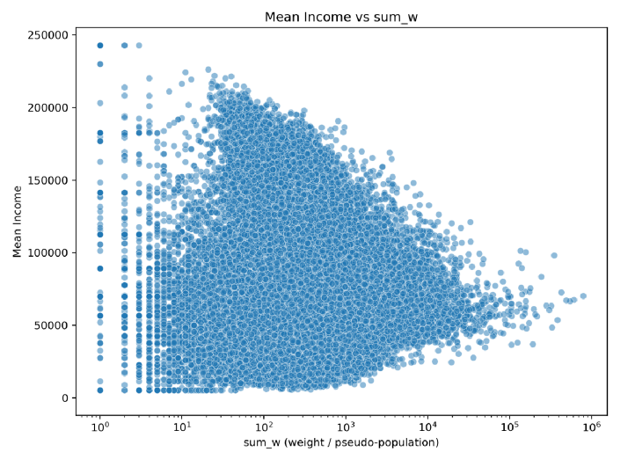
14
Additional Data Insights
Low-population regions → higher variance
DP noise impacts them more
Fig 9. Scatter plot of mean income vs. pseudo-population
(sum_w). Higher populations show narrower income vari
ability, while low-population regions show wider spread
CIS 455
Data Security and Privacy
Team CyberSentinels
Notes:
Farhan

Slide 16
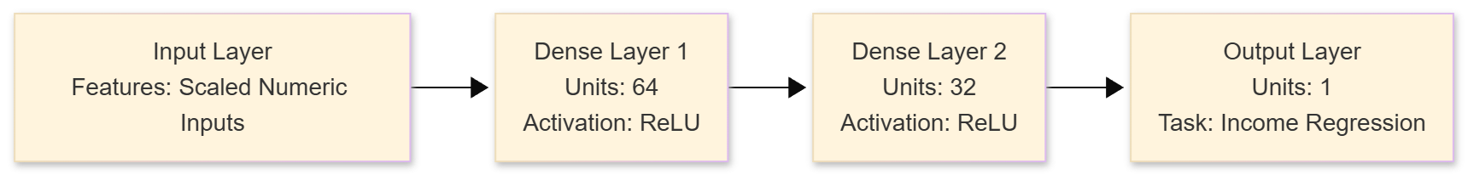
15
Machine Learning Component
Fig 9. Diagram of ML Workflow and ML Model Architecture
Models used:
Baseline Linear Regression
DP-SGD Regression (TensorFlow Privacy)
DP-SGD settings: ε≈1, δ=1e-5, noise multiplier=1.1
CIS 455
Data Security and Privacy
Team CyberSentinels
Notes:
Ahmad

Slide 17
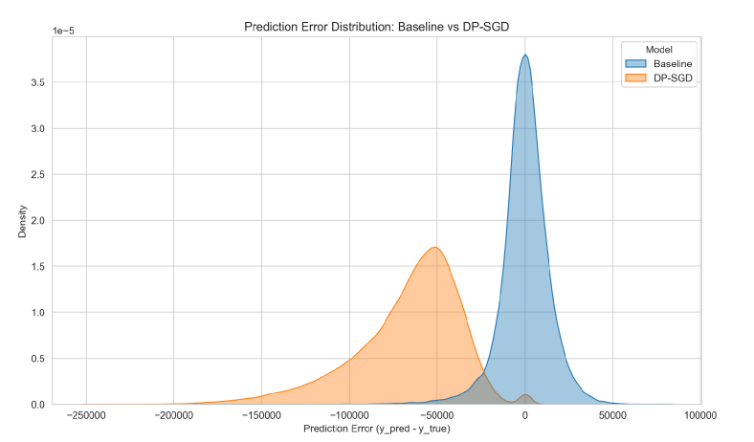
16
ML Results: Error Distribution
Findings:
Baseline error tightly centered
DP-SGD shows heavy negative skew, wide spread
DP noise strongly reduces ML utility
Fig 11. Prediction error density for baseline Linear Regression vs. DP-SGD model. DP-SGD exhibits significantly larger error
variance and negative skew
CIS 455
Data Security and Privacy
Team CyberSentinels
Notes:
Ahmad

Slide 18
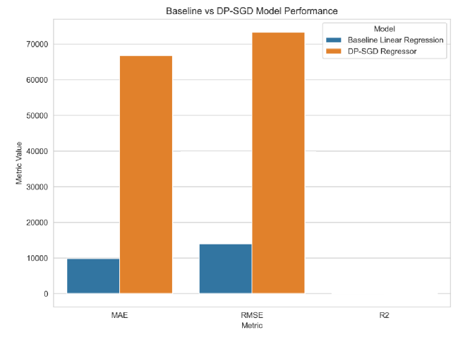
17
ML Metrics Comparison
Summary:
MAE & RMSE significantly worse for DP-SGD
R² near zero → poor predictive power
Fig 12. MAE, RMSE and 𝑅2 comparison between baseline
and DP-SGD models. The DP-SGD model suffers significant
performance degradation but ensures (𝜖,𝛿)-DP
CIS 455
Data Security and Privacy
Team CyberSentinels
Notes:
Ahmad

Slide 19
18
Key Takeaways
Laplace vs Gaussian
Impact of DP
Laplace is better for small ε. Laplace has higher bias but lower relative error
Low ε → high noise, low accuracy
Skewed income data amplifies errors
Gaussian performs worse at low ε. Gaussian more stable overall
ML under DP-SGD loses significant utility
CIS 455
Data Security and Privacy
Team CyberSentinels
Notes:
Ahmad

Slide 20
19
Conclusion & Future Work
Conclusion
Differential Privacy effectively protects sensitive socioeconomic statistics.
Strong privacy (low ε) introduces high noise and reduces accuracy.
Heavy-tailed income distributions amplify DP error.
Gaussian mechanism more stable at higher ε; Laplace better for small ε.
ML under DP-SGD shows significantly reduced utility.
Limitations
Income data are highly skewed, increasing sensitivity and noise impact.
Median and standard deviation are more sensitive to DP noise.
DP-SGD regression shows poor predictive performance (low R², large error).
Future Work
Explore Rényi Differential Privacy and advanced privacy accounting.
Improve sensitivity bounding techniques.
Test alternative DP machine learning architectures.
CIS 455
Data Security and Privacy
Team CyberSentinels
Notes:
Ahmad

Slide 21

CIS 455
Data Security and Privacy
Team CyberSentinels
Notes:
Thank you for listening. We’re happy to take any questions.

